Slide 1
Data Visualization: Empowering Business with Effective Insights
By
Prashanth Kumar Kadasi

Slide 2
Tools used
Alteryx
Tableau

Slide 3
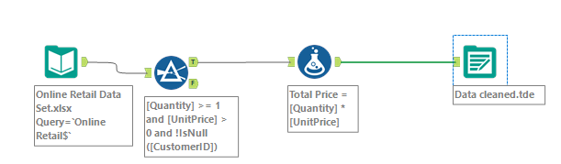
Data cleaning
I have used Alteryx for data cleaning and get output file in tableau format
This will save more time for data cleaning and load time will be less in tableau
Used below workflow to remove null values and negative values, then calculated total sales then exported to tableau format

Slide 4
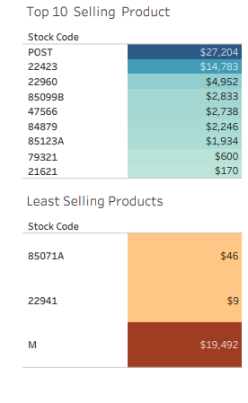
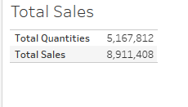

Slide 5
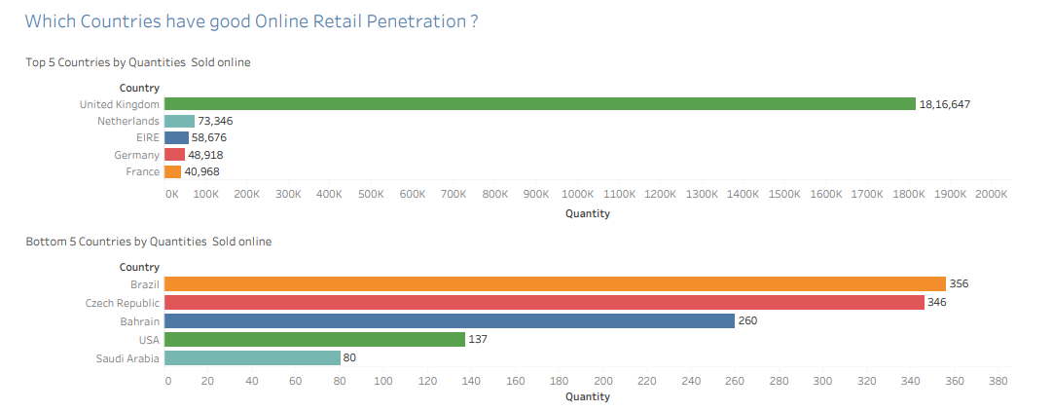
Top 5 and bottom 5 countries

Slide 6
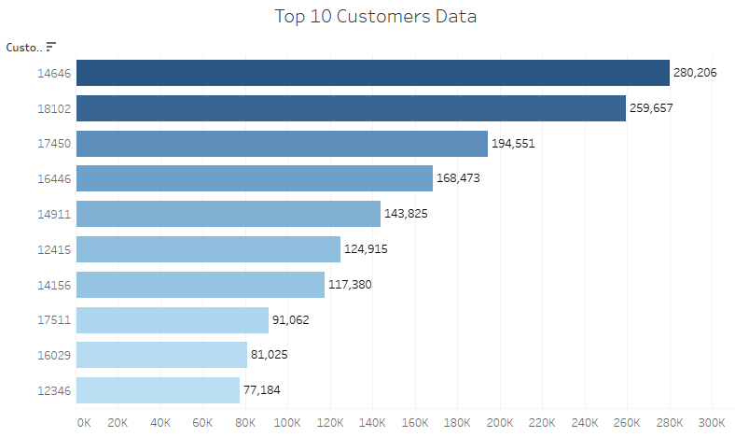
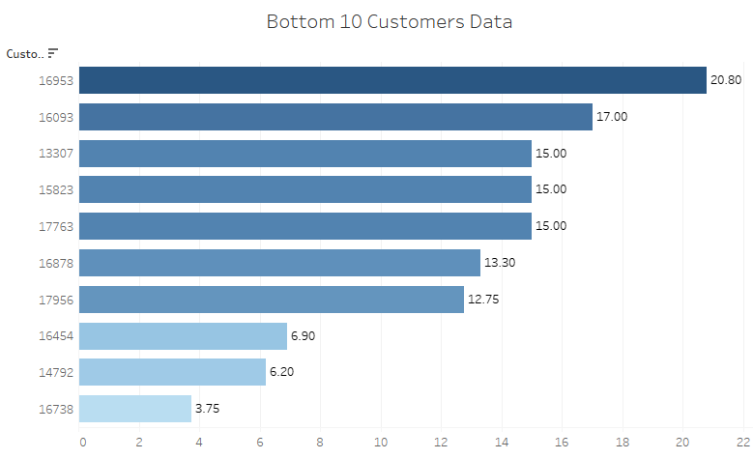
Top & Bottom 10 customers

Slide 7
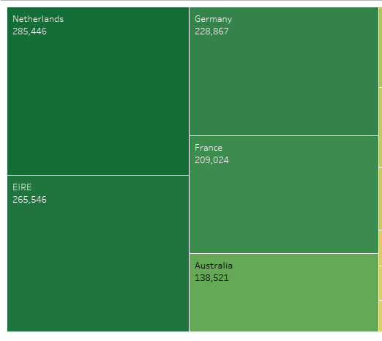
Where we can expand our network

Slide 8


